Slide 1

Supply Chain Management Analytics
T
The objective of this project is to demonstrate how a simulated SAP and ERP system can be used to analyze material requirements, verify bills of materials(BOMs), track inventory levels, monitor order delinquencies, and evaluate on-time delivery. These analyses support operational efficiency , strengthen cost control, and improve supply chain visibility.
System Activities
Monitor material availability and review material requirements.
Access BOMs to assess material capability for production scheduling.
  Check material stock, storage locations, and quantities.
  View freight order statuses.
  Monitor delivery performance.

Slide 2
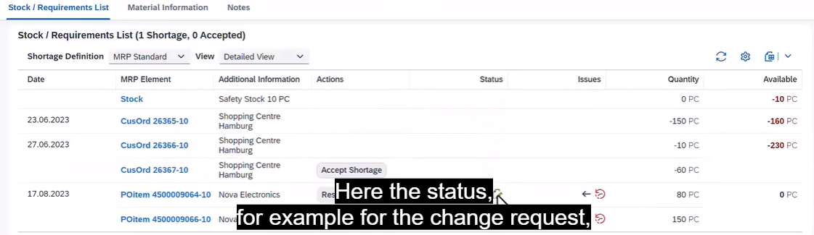
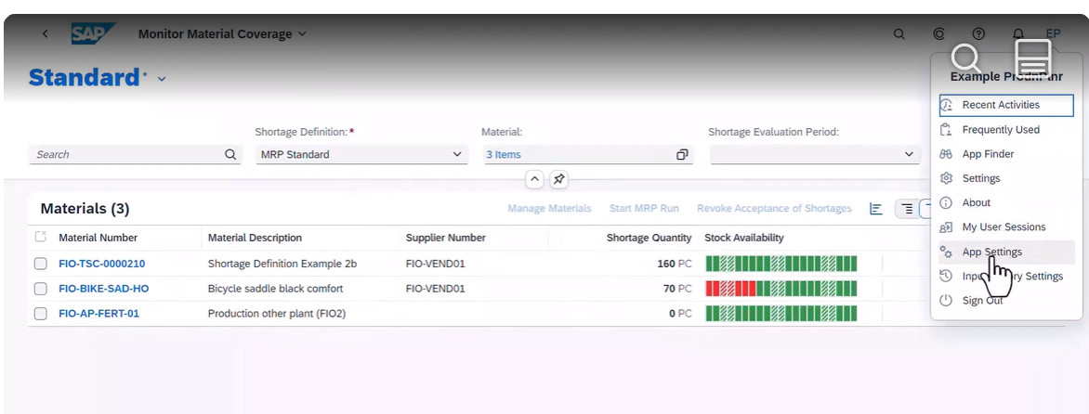
Material Requirements
Material requirement planning elements appear with a negative number in red for quantity and availability.
Material requirements planning elements display the stock quantity and stock availability as positive numbers in pieces.

Slide 3
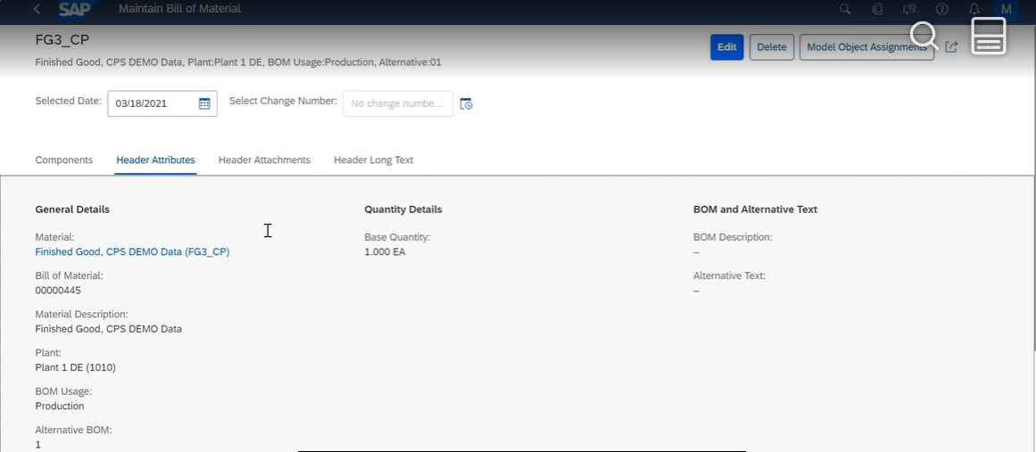
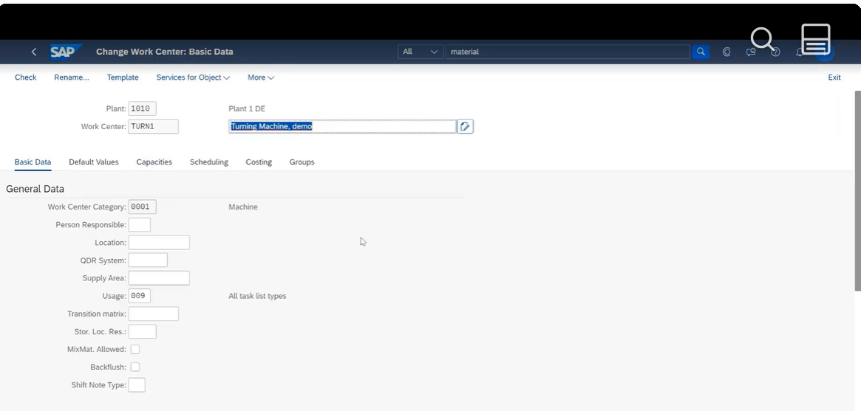
Bill of Materials
Review BOM details, including its description, quantity, and plant location, to determine whether materials are available to schedule production.
Once material availability is confirmed, create a work order to allocate quantity for the specified production plant location.

Slide 4
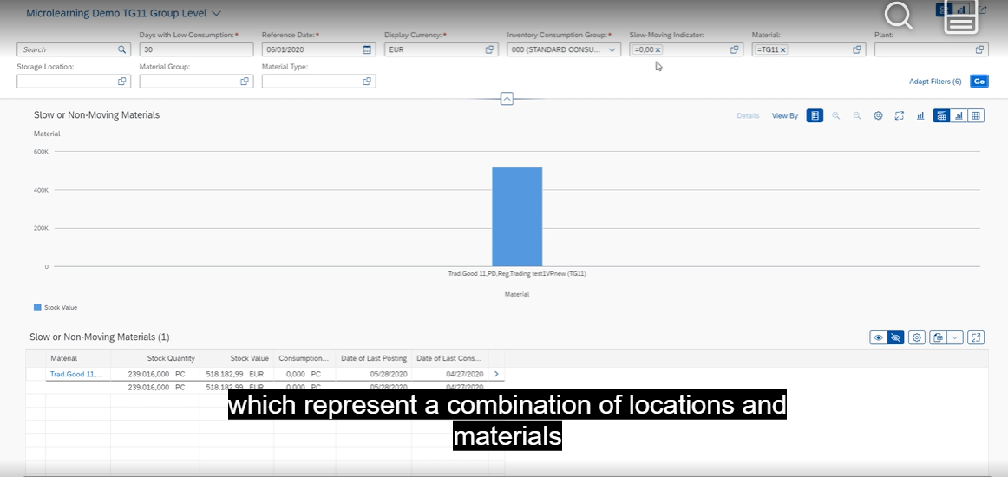
Inventory Levels
Search for a specific material number to view its stock quantity.

Slide 5
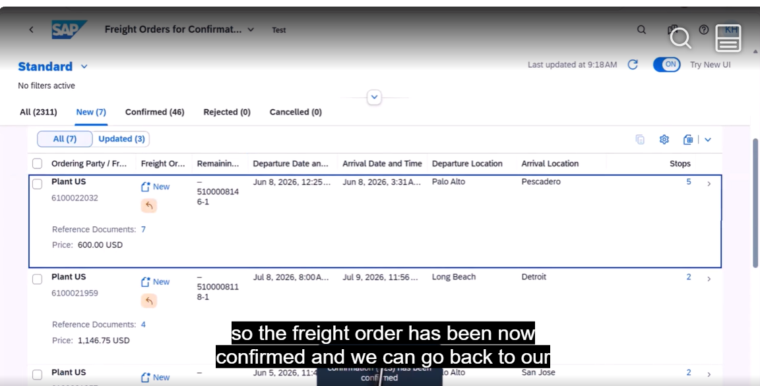
Order Delinquencies
This freight order confirmation shows the order arrival location and time.

Slide 6
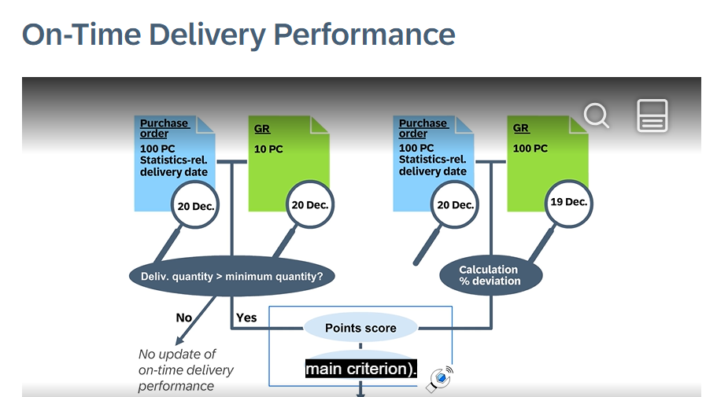
Delivery Performance
In comparison, this diagram shows that the goods receipt (GR) quantity reflects a difference (shortage) on September 20.

